Slide 1
Sports Adages Explored through Data Analysis
Presented by:
Hunter Carraway
Austin Dickerson
Matt Fleischer
Karl Meyer

Slide 2
Sports Adages Explored through Data Analysis
Which of the following help a NCAAF football team win the most efficiently?
Offense wins games.
Defense wins championships.
Punting wins field position.
Our goal is to predict the winner of each game depending on the correct metric.

Slide 3
Data And Data Sources
Variable | Measure | Type | Source
Team | Categorical | String | ESPN
Pass Yards/ Game | Average Yds | Double | ESPN
Rush Yards/Game | Average Yds | Double | ESPN
Win Percentage | # G Won / # G Played | Double | ESPN
Yards Against/Game | Average Yds | Double | ESPN
Net Punt | Average Yds | Double | ESPN
Punt Ret Yds/Game | Average Yds | Double | ESPN
Winning Record (6+) | T/F from Win Percent | Boolean | Created

Slide 4
Analysis of Numerical Summaries
Winning Record | Yes | No | Total
Total | 71 | 48 | 119
Winning Record skewed left because FCS teams involved (95-16)
Max of Yds/Game (Baylor) is an outlier
(Q3 + 1.5 x IQR) = 588.25
All 3 numerical variables are very uniformly distributed (mean ≈ median)
 | YDSG | YDSAG | Net Punt
Count | 119 | 119 | 119
Mean | 412.00 | 397.42 | 37.06
Std Deviation | 64.73 | 55.33 | 3.42
Minimum | 256.00 | 252.00 | 31.30
1st Quartile | 367.00 | 366.00 | 35.85
2nd Quartile | 411.00 | 398.00 | 36.90
3rd Quartile | 455.50 | 426.50 | 38.25
Maximum | 619.00 | 528.00 | 42.40

Slide 5
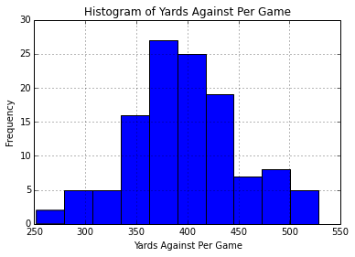
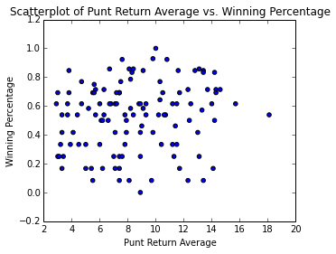
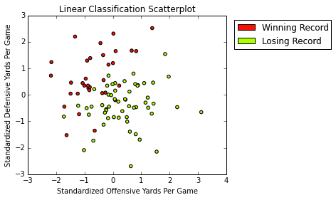
Visualizations

Slide 6
Machine Learning Algorithm
•We employed a linear classification model, using certain features from our data to determine which contributed most to a higher winning percentage
•A feature is an important feature if it is marked with an *, meaning its p-value is below 0.05

Slide 7
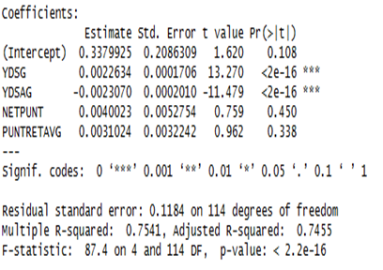
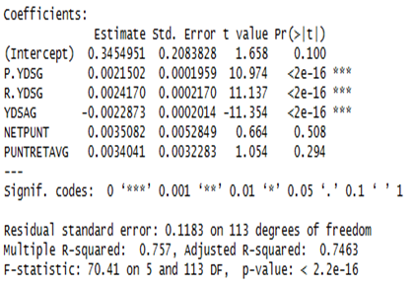
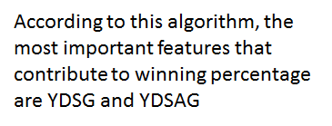
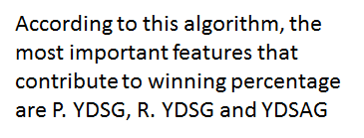
Results

Slide 8
Conclusions & Recommendations
results are as is expected, both algorithms show that they most important values were the passing & running yards per game, and both showed that the yards allowed by the defense per game was also important
however, we have one algorithm that says that offensive yards are slightly more important than defensive, and the other algorithm says the opposite--contradiction, but going to conclude that offense is more important
recommend that the second algorithm be amended to have only one category for yards gained by the offense so that it better matches the importance and the results from the first algorithm
recommend that further analysis should be done on the strength correlation between the three important features listed above and the overall outcome of the winning percentage or rating of an offense and the overall effectiveness and rating of a defense
recommend that future analysis includes looking into the definability of certain teams into a strong defensive or offensive team, and their winning percentage based on their individual players’ statistics--much harder

